Slide 1

Introduction to Clinical Pharmacology Chapter 26 Cholinergic Blocking Drugs

Slide 2
Learning Objectives
Explain the uses, general drug actions, general adverse reactions, contraindications, precautions, and interactions of the cholinergic blocking drugs (also called anticholinergic drugs and cholinergic blockers).
Distinguish important preadministration and ongoing assessment activities the nurse should perform on the client taking a cholinergic blocking drug.
List nursing diagnoses particular to the client taking a cholinergic blocking drug.
Examine ways to promote an optimal response to therapy, how to manage common adverse reactions, and important points to keep in mind when educating clients taking cholinergic blocking drugs.

Slide 3
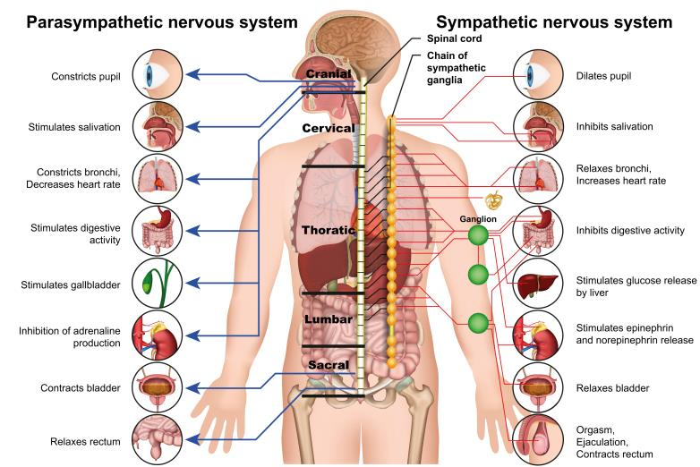
Autonomic Nervous System
Division of the peripheral nervous system concerned with the functions essential to life of an organism and not consciously controlled (e.g., blood pressure, heart rate, and gastrointestinal activity)
Divided into two branches:
Sympathetic
Parasympathetic

Slide 4
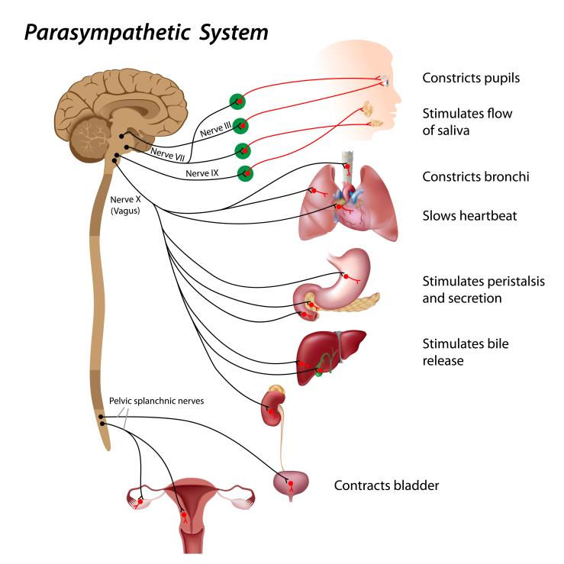
Parasympathetic Nervous System #1
Blocking the parasympathetic nervous system is like stimulating the sympathetic nervous system
Acetylcholine (Ach) is the neurotransmitter of the parasympathetic branch of the autonomic nervous system

Slide 5
Parasympathetic Nervous System #2
Muscarinic receptors: stimulate smooth muscle
Nicotinic receptors: stimulate skeletal muscle
Cholinergic blocking drugs are selective and target just one of the types of receptors

Slide 6
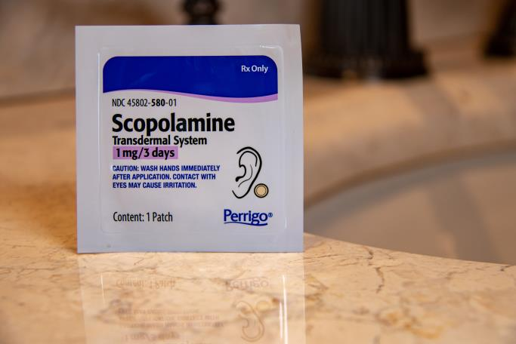
Cholinergic Blocking Drugs—Actions
Block/inhibit the action of acetylcholine (ACh) in the parasympathetic nervous system
Cholinergic blocking drugs are selective and target just one of the types of receptors
Can affect many organs and structures of the body if they are nonselective
Example: scopolamine

Slide 7
Cholinergic Blocking Drugs—Uses
Maintenance treatment of asthma or COPD
Ureteral or biliary colic and bladder overactivity
Pylorospasm and peptic ulcer
Vagal nerve–induced bradycardia
Preoperative reduction of oral secretions

Slide 8

Pharmacology in Practice Exercise #1
Oxybutynin, used for the treatment of overactive bladder, exerts its effect by inhibiting the action of which of the following receptors?
Nicotinic receptors
Alpha-adrenergic (α–adrenergic) receptors
Muscarinic receptors
Beta-adrenergic (β-adrenergic) receptors

Slide 9

Cholinergic Blocking Drugs—Adverse Reactions #1
Gastrointestinal System Reactions:
Dry mouth
Nausea, vomiting
Difficulty swallowing
Heartburn
Constipation

Slide 10

Cholinergic Blocking Drugs—Adverse Reactions #2
Central Nervous System Reactions:
Headache, flushing, nervousness
Drowsiness, weakness, insomnia
Nasal congestion
Fever

Slide 11

Cholinergic Blocking Drugs—Adverse Reactions #3
Visual Reactions:
Blurred vision
Mydriasis
Photophobia
Cycloplegia
Increased ocular tension

Slide 12

Cholinergic Blocking Drugs—Adverse Reactions #4
Genitourinary System Reactions:
Urinary hesitancy
Urinary retention
Dysuria

Slide 13

Cholinergic Blocking Drugs—Adverse Reactions #5
Cardiovascular System Reactions:
Palpitations
Bradycardia (low doses of atropine)
Tachycardia (high doses of atropine)

Slide 14

Cholinergic Blocking Drugs—Adverse Reactions #6
Other Reactions:
Urticaria
Decreased sweat production
Anaphylactic shock
Rash

Slide 15

Cholinergic Blocking Drugs—Contraindications
Contraindicated in clients with:
known hypersensitivity to the drugs
glaucoma
myasthenia gravis
tachyarrhythmia
myocardial infarction
heart failure (unless bradycardia is present)

Slide 16
Cholinergic Blocking Drugs—Precautions
Use cautiously in clients with:
GI infection
Benign prostatic hypertrophy
Urinary retention
Hyperthyroidism
Hepatic or renal disease
Hypertension
Asthma
pregnancy (pregnancy category C) or lactation
use cautiously in clients over 65 years old

Slide 17
Cholinergic Blocking Drugs—Interactions
Interacting Drug | Common Use | Effect of Interaction
Antibiotics/ Antifungals | Anti-infective agents | Decreased effectiveness of anti-infective drug
Meperidine, flurazepam, phenothiazines | Preoperative sedation | Increased effect of the cholinergic blocker
Tricyclic antidepressants | Management of depression | Increased effect of the cholinergic blocker
Haloperidol | Antianxiety/ antipsychotic agent | Decreased effectiveness of the antipsychotic drug
Digoxin | Management of cardiac problems | Increased serum levels of digoxin

Slide 18
Pharmacology in Practice Exercise #2
A client who was prescribed a cholinergic blocking drug is concerned about drug interactions. The client informs the nurse that he is taking the antidepressant Wellbutrin? What antidepressant drug class interacts with cholinergic blockers?
Selective serotonin reuptake inhibitors
Serotonin-norepinephrine reuptake inhibitors
Tricyclics
Monoamine oxidase inhibitor

Slide 19

Nursing Process—Client Receiving a Cholinergic Blocking Drug #1
Preadministration Assessment
Prior to administration for surgical purposes or ulcer management
Objective Data
Vital signs
Description of signs such as occult blood in stool for peptic ulcer, visual acuity for glaucoma
Measure for weight loss or dehydration

Slide 20

Nursing Process—Client Receiving a Cholinergic Blocking Drug #2
Preadministration Assessment (continued)
Prior to administration for surgical purposes or ulcer management
Subjective Data
History of general health and wellness
Pain experience: onset, type, radiation, location, intensity, and duration
Client’s description of symptoms of the current disorder
Remedies attempted before seeking care

Slide 21

Nursing Process—Client Receiving a Cholinergic Blocking Drug #3
Ongoing Assessment
Check vital signs; observe for adverse drug reactions; evaluate the symptoms and complaints related to the client’s diagnosis
Compare ongoing assessment to baseline assessment
Document and report any increase in severity of symptoms to primary health care provider immediately

Slide 22
Nursing Process—Client Receiving a Cholinergic Blocking Drug #4
Nursing Diagnosis
Impaired Comfort related to xerostomia
Constipation related to slowing of peristalsis in GI tract
Injury Risk related to dizziness, drowsiness, mental confusion, impaired vision, or heat prostration
Ineffective Tissue Perfusion related to impaired heart pumping action

Slide 23
Nursing Process—Client Receiving a Cholinergic Blocking Drug #5
Planning
Expected client outcomes depend on the reason for administration of the cholinergic blocking drug but may include:
Optimal response to therapy
Management of adverse drug reactions
Confidence in an understanding of the prescribed medication regimen

Slide 24
Nursing Process—Client Receiving a Cholinergic Blocking Drug #6
Implementation
Promoting Optimal Response to Therapy
Client receiving a preoperative drug:
Give at exact time prescribed
Instruct the client to void before the drug is given
Inform the client that drowsiness and dry mouth will occur within 20 to 30 minutes, that this is normal, and that fluid is not to be taken
Instruct the client to remain in bed after administration of preoperative drug; raise side rails

Slide 25

Nursing Process—Client Receiving a Cholinergic Blocking Drug #7
Implementation
Monitoring and Managing Client Needs
Impaired Comfort: Xerostomia
Encourage client to take a few sips of water before and while taking an oral drug and to sip water at intervals during meals
Encourage client to suck on sugarless hard candy if allowed
Check oral cavity daily for soreness or ulcerations

Slide 26

Nursing Process—Client Receiving a Cholinergic Blocking Drug #8
Implementation
Monitoring and Managing Client Needs
Constipation
Urge client to increase fluid intake up to 2000 mL daily; eat a diet high in fiber; obtain adequate exercise
Reassure client that increasing fluids will minimize adverse reaction
Primary health care provider may prescribe a stool softener, if necessary, to prevent constipation

Slide 27

Nursing Process—Client Receiving a Cholinergic Blocking Drug #9
Implementation
Monitoring and Managing Client Needs
Injury Risk
Drugs may cause drowsiness, dizziness, blurred vision, photophobia; monitor the client for any disturbance in vision
Instruct client to wear sunglasses when going outside even on cloudy days for photophobia; provide semi-dark/dimly lit room

Slide 28

Nursing Process—Client Receiving a Cholinergic Blocking Drug #10
Implementation
Monitoring and Managing Client Needs
Injury Risk (continued)
Elderly client should be observed at frequent intervals for excitement; agitation; mental confusion; drowsiness; urinary retention
Client should be taught to call for assistance to prevent injury when ambulation is required
Mydriasis and cycloplegia may develop; screen time should be limited to reduce the strain on the eyes

Slide 29

Nursing Process—Client Receiving a Cholinergic Blocking Drug #11
Implementation
Monitoring and Managing Client Needs
Injury Risk (continued)
Elderly clients are especially at risk for decreased sweating and heat prostration and should be observed frequently for signs of overheating
Teach client to avoid going outside on hot, sunny days; use fans to cool the body; sponge the skin with cool water; wear loose-fitting clothing in warm weather
Hold dose of drug if heat prostration is suspected

Slide 30

Nursing Process—Client Receiving a Cholinergic Blocking Drug #12
Implementation
Monitoring and Managing Client Needs
Ineffective Tissue Perfusion
For the client receiving atropine for third-degree heart block, monitor for change in pulse rate or rhythm; place on cardiac monitor
Failure of drug to increase the heart rate must be reported to the primary health care provider immediately

Slide 31

Pharmacology in Practice Exercise #3
Which of the following interventions should the nurse perform when caring for a client receiving a cholinergic blocking drug and who is experiencing constipation?
Place items against walls to ensure clear path to bathroom
Engage in handwork activities
Monitor food intake to be sure the client is easting fiber-rich foods
Monitor for a change in pulse rate or rhythm

Slide 32

Nursing Process—Client Receiving a Cholinergic Blocking Drug #13
Implementation—Educating the Client and Family
Emphasize the importance of uninterrupted drug therapy, even if symptoms have been relieved
Teach the client and family about the common adverse reactions and measures to lessen the intensity of adverse reactions
Encourage client to discuss adverse reactions with primary health care provider

Slide 33
Nursing Process—Client Receiving a Cholinergic Blocking Drug #14
Evaluation
Was the therapeutic effect achieved?
Were adverse reactions: identified, reported, and managed?
Mucous membranes remain moist
Client reports adequate bowel movements
No evidence of injury
Tissue perfusion is maintained
Did client and family express confidence and demonstrate understanding of drug regimen?

Slide 34

Turn and Talk—Case Study #1
A 74-year-old client presents to the clinic complaining of symptoms of overactive bladder. The physician writes a prescription for tolterodine (Detrol LA) 4 mg every day.
What adverse reactions should be included in the nurse’s teaching plan for this client?
What specific adverse reactions of a cholinergic blocking drug should the nurse monitor for in this client due to them being 74 years old?

Slide 35
Turn and Talk—Case Study #2
A 74-year-old client presents to the clinic complaining of symptoms of overactive bladder. The physician writes a prescription for tolterodine (Detrol LA) 4 mg every day.
A few weeks later the client calls the physician’s office complaining of dry mouth symptoms. What should the nurse recommend to the client to reduce the dry mouth discomfort?

